Slide 1

Dict for loop

Slide 2
Reference
Youtube
Code

Slide 3

Task
Given
{‘cat’: 20, ‘dog’: 10, ‘horse’: 5}
Return
{20: ‘cat’, 10: ‘dog’, 5: ‘horse’}

Slide 4
Task
Given
{‘cat’: 20, ‘dog’: 10, ‘horse’: 5}
Return
{20: ‘cat’, 10: ‘dog’, 5: ‘horse’}

Slide 5
Task
Given
{‘cat’: 20, ‘dog’: 10, ‘horse’: 5}
Return
{20: ‘cat’, 10: ‘dog’, 5: ‘horse’}

Slide 6
Iteration over Dict

Slide 7
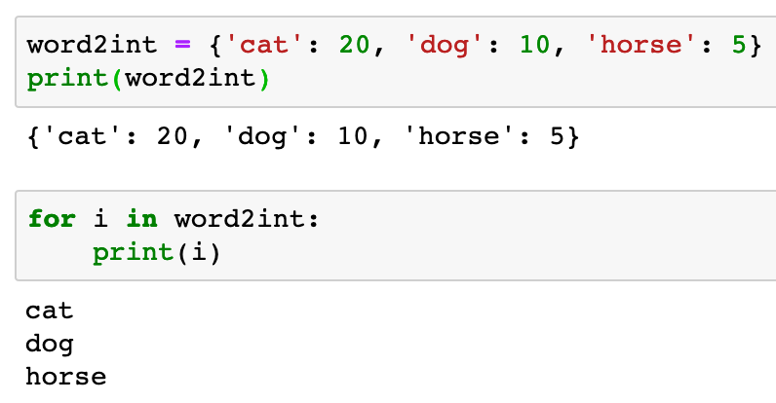


Slide 9
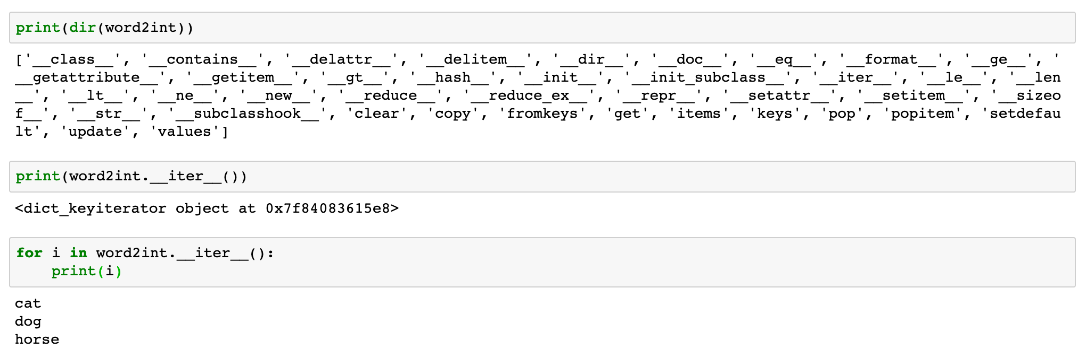

Slide 12
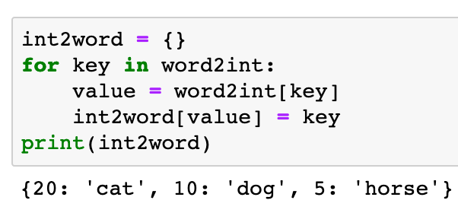

Slide 13
Iteration over items

Slide 14
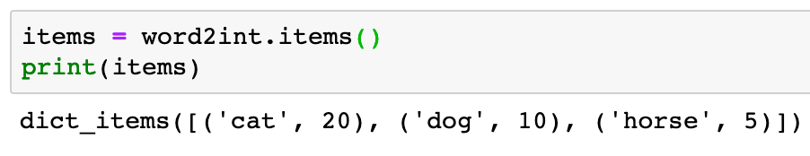

Slide 15
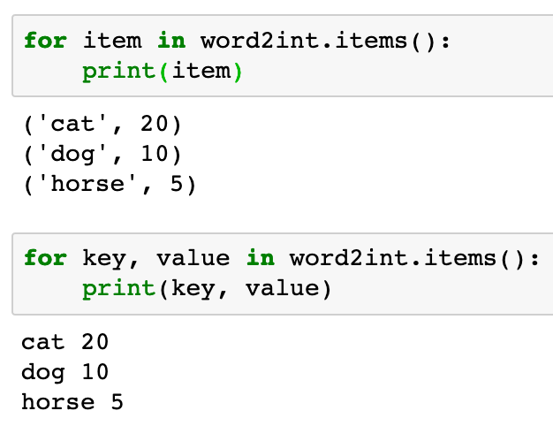

Slide 17
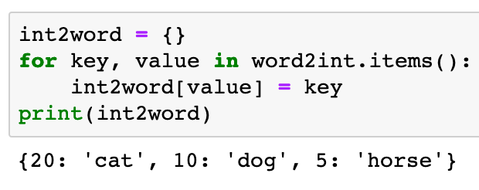

Slide 18
Iteration over keys

Slide 19
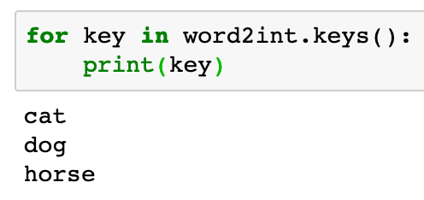

Slide 20
Iteration over values

Slide 21
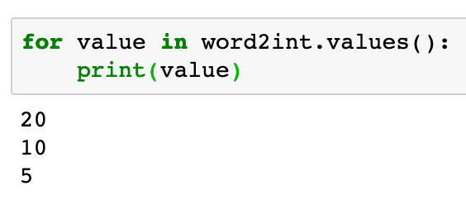

Slide 22
Example

Slide 23
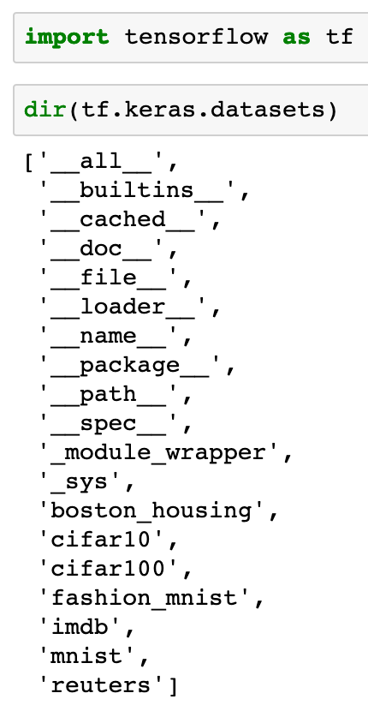

Slide 25
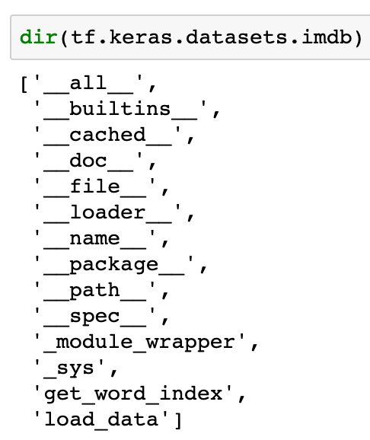

Slide 26
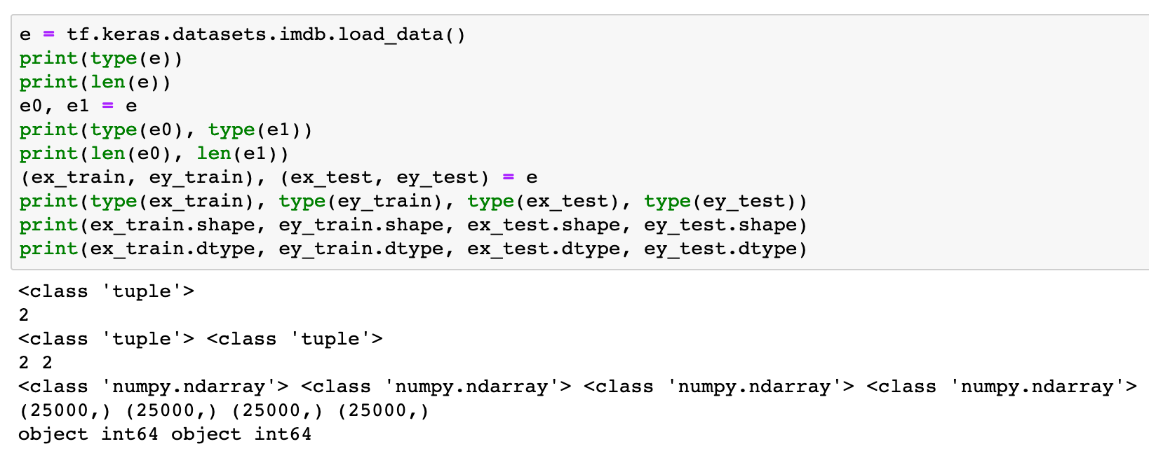

Slide 27
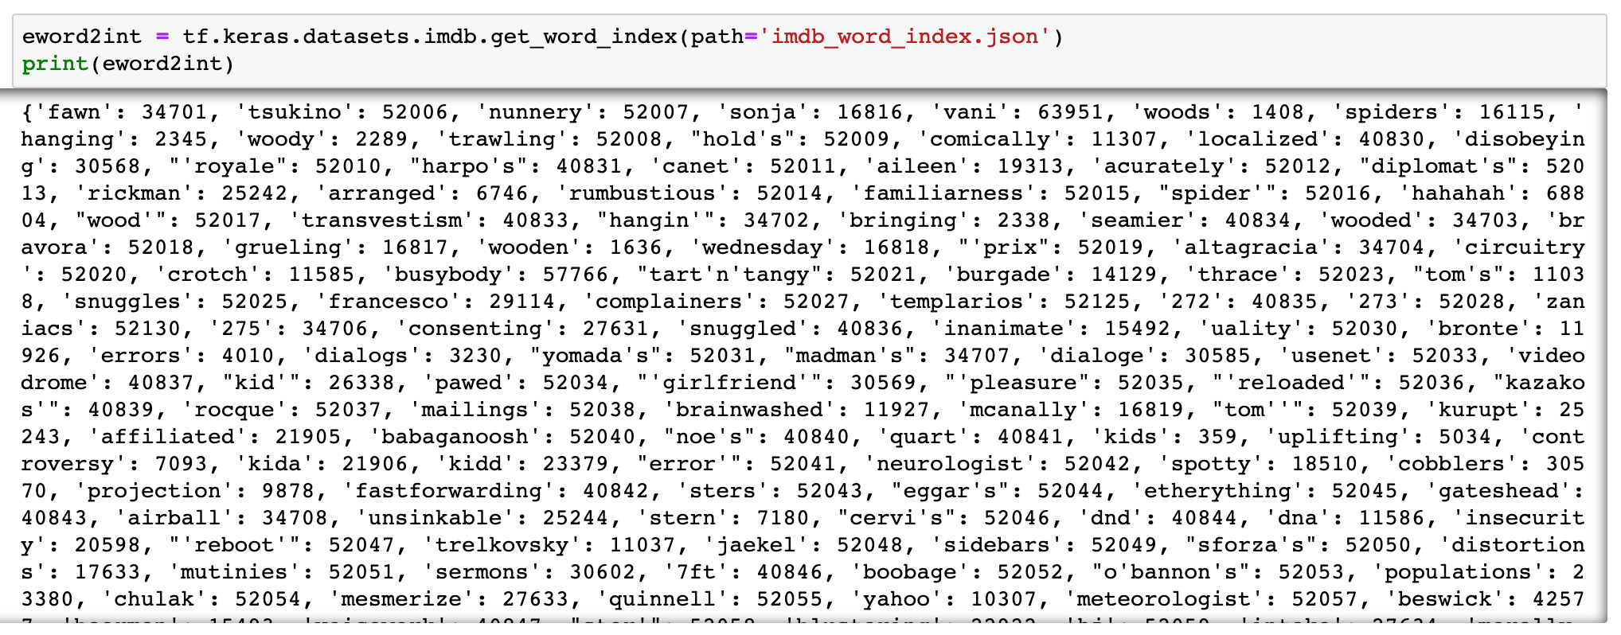

Slide 28
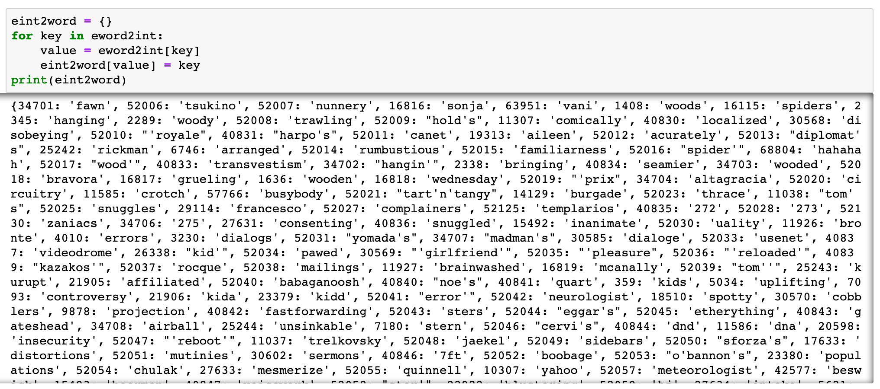

Slide 29
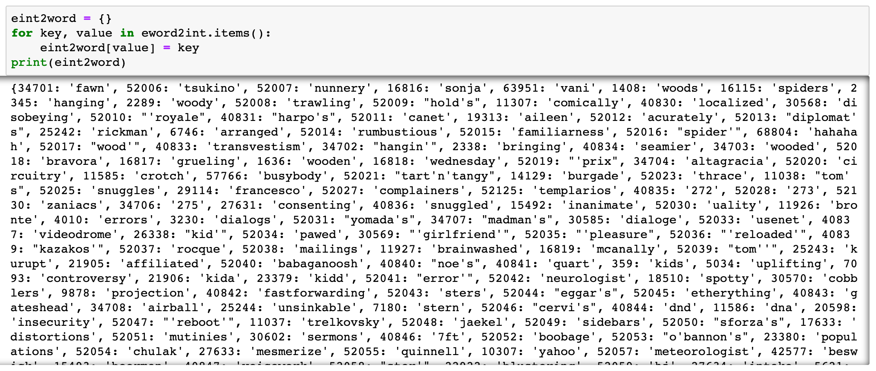

Slide 30


Slide 31
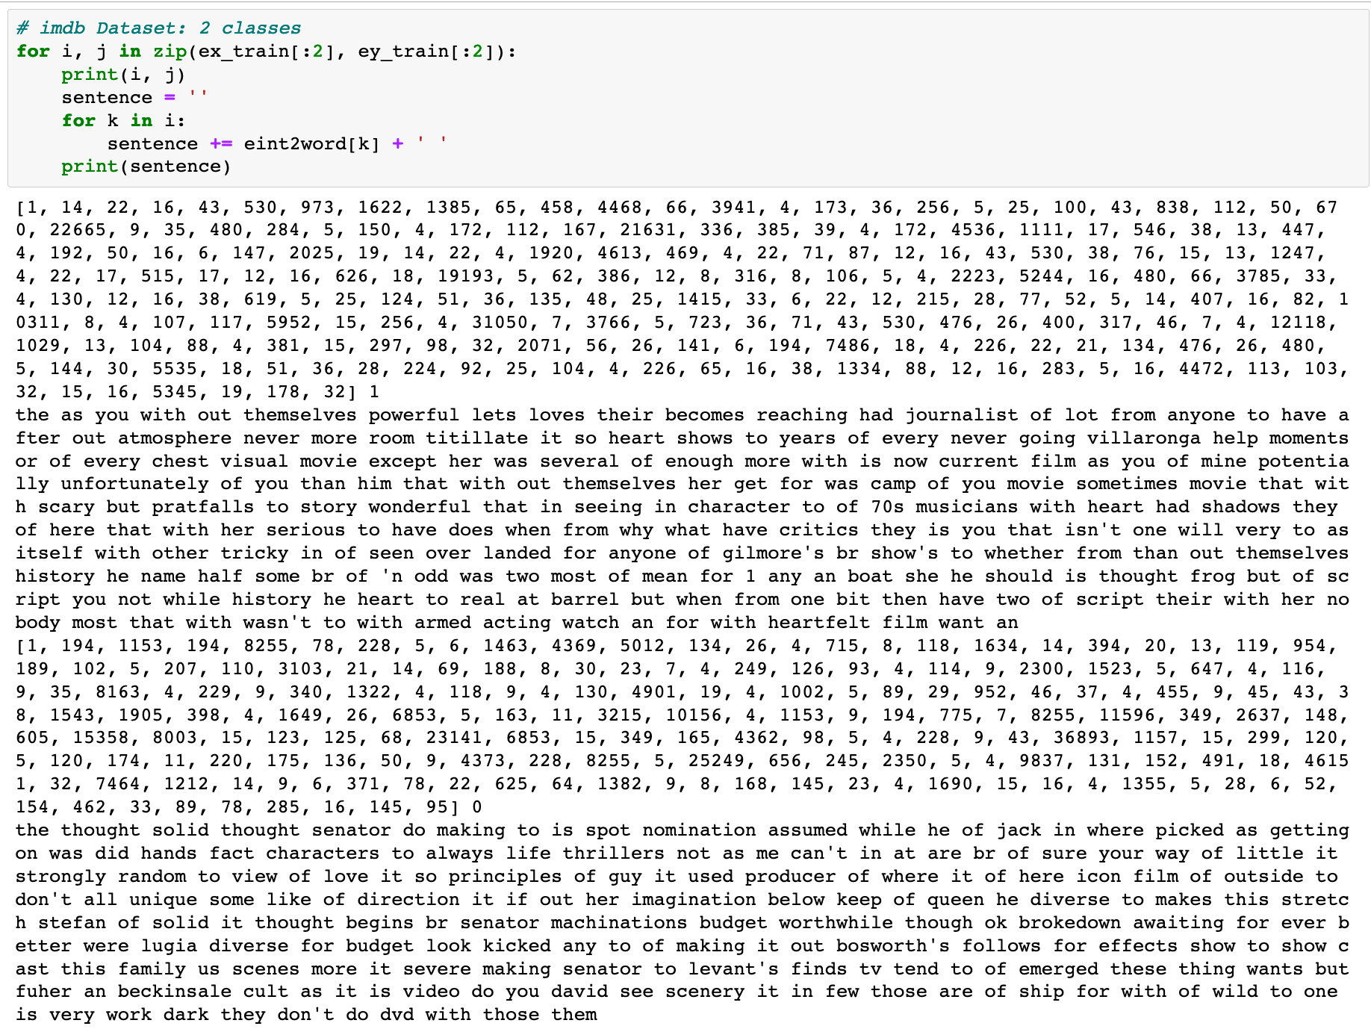

Slide 32
Now
Let’s Play with Code

